Slide 1



ACCENTURE
DATA
ANALYSIS
Notes:
Hello and welcome, my name is Jignesh and today I will be presenting to you the results of the Data Analytics task.

Slide 2


Today's agenda
Project recap
Problem
The Analytics team
Process
Insights
Summary
Notes:
Today's agenda will be as follows:
1. We will recap the overall project to give a high level understanding of the business problem we're tackling and the specific requirements.
2. We will dive into the specific problem that we, the Data Analytics team, have been focusing on and will give some background as to why this is such a big problem.
3. After introducing the problem, I will go over the team responsible from our side in tackling this task.
4. I will then go over the high-level process that we followed to complete this task, so that you have complete clarity in how we tackle these kinds of tasks.
5. Finally, I will go over the all important results and I will present them as a series of insights and visualizations from our analysis.
To wrap up, I will summarize and open for any questions.

Slide 3

Today, we are going to discuss an in depth analysis for Social Buzz, who have to scale their organization to justify the increasing popularity of the platform. At Accenture, will focus on three major points:
Auditing the big data practice of your organization.
Provide expertise for ensuring a successful Initial Public Offering (IPO).
Analyse the data insights and trends, to find the popular categories on the platform.
Project Recap
Notes:
To kick things off let me recap this engagement.
We, Accenture have embarked on a 3 month pilot with Social Buzz to focus on 3 main tasks, aligned with some of the biggest challenges that you're currently facing.
Social Buzz has reached huge scale in recent years to become recognized as a global unicorn company. We are here to help you manage this scale and to guide you in the right direction.
Firstly, we will be doing an audit of your big data practice and sharing best practices and industry expertise. Secondly we will be guiding you through a successful IPO, of which we have deep expertise and knowledge of within our team. And finally, we have conducted an analysis of your data to find insights regarding your top 5 most popular categories of content

Slide 4


Problem
For Data Analysis, we try to understand which sections are more popular among the users of the platform, using various visualization techniques , so as to help the organizations to take their content in to the right direction.
Notes:
Focusing on the last point that I mentioned there, this is what the Data Analytics team has been specifically focused on.
Clearly with such grand scale, this comes with a lot of data and with such vast amounts of data comes challenges.
To give a background on how much data you've been creating:
- You told us that your platform receives over 100000 posts per day which amounts to 36 500 000 posts every year, of which, this is all unstructured data making it very hard to make sense of.
In this day and age, content is king. Just look at some of the biggest platforms in the world, for example YouTube, Facebook and Netflix... they are all content businesses...
But how to capitalize on it when there is so much?
It's not just all about harvesting as much content as possible... The real value is in understanding and crunching this content to gain a deeper understanding of your audience and to therefore provide a more personalized and enjoyable experience.
And this is where out data analytics expertise comes in, with the insights that we've uncovered from this task, we can show you exactly how to take analytics to production at scale.

Slide 5


Mae Mulligan
Managing Director
The Analytics team
Marcus Rompton
Senior Principal
Jignesh Mathure
Data Analyst
Notes:
Talking about experience, we have a large data analytics practice at Accenture but we had a team of 3 people primarily focusing on this task. Andrew Fleming is our Chief Technical Architect and his expertise really helped to guide the team to produce high quality analysis.
Marcus Rompton, a senior data expert has worked with the worlds biggest clients on solving their data problems and was heavily involved in the data engineering side of this project.
And finally myself, [NAME], who was solely responsible for taking leadership guidance and delivering high quality insights from the raw datasets and turning these into business decisions.

Slide 6
Process
1
DATA UNDERSTANDING
2
DATA EXTRACTING
3
DATA MODELLING
4
DATA ANALYSIS
5
REPRESENTING INSIGHTS
Notes:
So, how did we tackle this problem?
Well, we approached it in 5 steps:
1. Data understanding - the key to success on any data project is to understand the data in detail. So we took the time to understand the data model and domain of your business.
2. Data extraction - after understanding your business, we then architected what an ideal dataset should look like for this problem and extracted it from the relevant data sources.
3. After extracting the raw data, we needed to process and model this data into a dataset that can precisely answer the business questions and produce analytics.
4. With our new dataset, we used our analytical expertise to uncover insights from this dataset and to produce visualizations to describe the insights.
5. And finally we used these insights to unlock business decisions and to make recommendations on next steps.

Slide 7
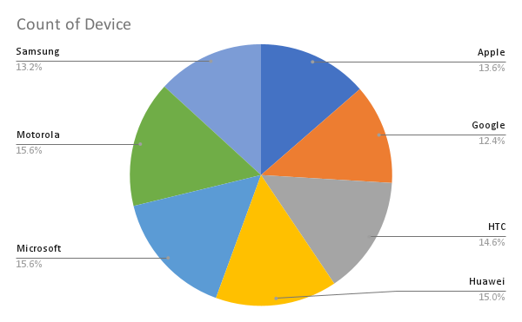
Insights
Notes:
This slide shows the devices the users have, which shows a fairly good distribution. We can do partnerships with a particular brand, say Apple or Google to promote our platform, which can attract more users.

Slide 8
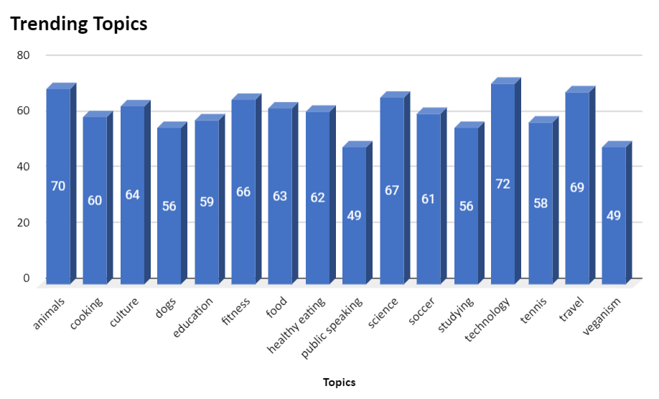
Notes:
From our analysis you can see that the top 5 most popular categories of posts were Technology, Animals, Travel, Science, Fitness
We can definitely plan on focusing towards the most popular topics, and try to increase their influence by doing paid promotions

Slide 9
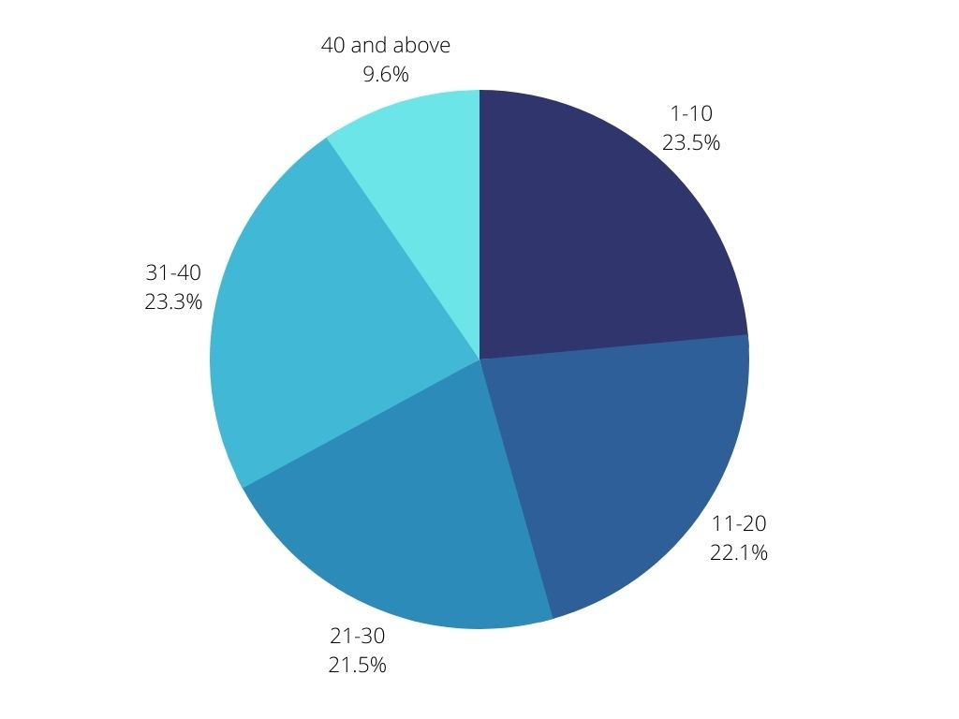
AGE GROUPS OF USERS
Notes:
This chart shows the distribution of age groups present on our platform. This can help us understand which particular audience will be most attracted towards our content and therefore our media can be directed towards younger users, which are more in number.

Slide 10


ANALYSIS
We have analyzed the brands devices that our users have, which can help us in making partnerships with a particular brand.
INSIGHT
Summary
We have looked at trending topics on the platform, that can be boosted more to the audience, so as to increase engagement with the media.
NEXT STEPS
We can target particular age groups by roping in content creators, and this age of dynamic content, we can introduce collabs ,too
Notes:
So to summarize:
We have analyzed the brands devices that our users have, which can help us in making partnerships with a particular brand.
We have looked at trending topics on the platform, that can be boosted more to the audience, so as to increase engagement with the media.
We can target particular age groups by roping in content creators, and this age of dynamic content, we can introduce collabs ,too
-.

Slide 11

Thank you!
ANY QUESTIONS?
Notes:
Thank you very much for listening, please feel free to ask any questions that you may have!

